Slide 1
Personal Finance Management System
GROUP NO - 7
Ankith Reddy Pati
Bhuvana Ravikumar
Sijoy Almeida
Haocheng Xu

Slide 2
INTRODUCTION
PURPOSE
The Personal Finance Management System revolutionizes the way individuals oversee their financial landscape, providing an intuitive platform to manage investments, bank transactions, and net worth. Tailored to simplify the complexities of personal finance, it delivers a comprehensive dashboard for insightful financial analysis and planning. This system is the cornerstone for anyone seeking to enhance their financial literacy and make informed decisions for a secure financial future.
To provide a user-friendly platform for individuals to track and manage their personal finances effectively.
To simplify the complex task of budgeting, tracking investments, bank transactions, and analyzing assets and liabilities.
To enable users to make informed decisions about their financial future by offering a comprehensive view of their financial status.

Slide 3
IMPORTANCE
OVERVIEW OF TECHNOLOGIES USED
Financial health is critical for personal well-being and security.
Effective management of finances can lead to increased savings, investment growth, and debt reduction.
Understanding personal cash flow helps in planning for short-term and long-term financial goals.
Proper financial management can provide a cushion against financial emergencies and enable individuals to make better spending choices.
Java Backend : Powers the core logic of the application with a robust, reliable structure.
MySQL Database: Stores and organizes user data, including transactions and financial records.
Java Swing UI: Provides a user-friendly interface for smooth interaction with the application.

Slide 4
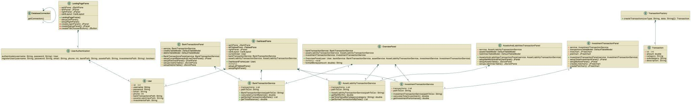
UML DIAGRAM

Slide 5
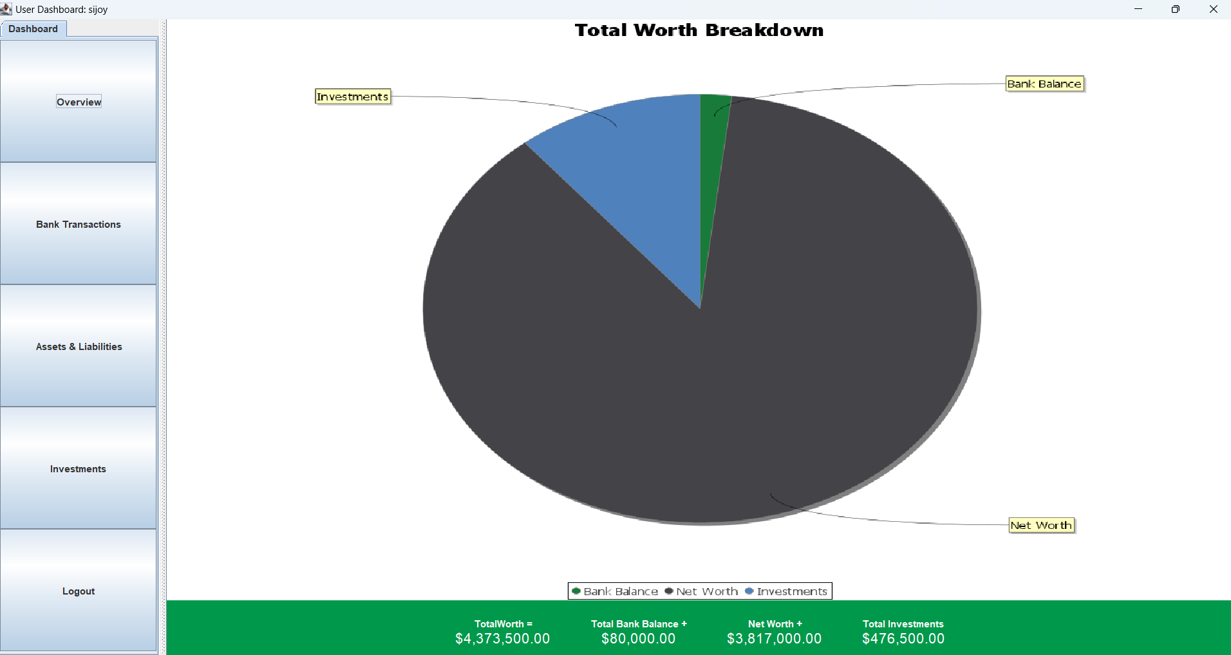
Dashboard VIEW

Slide 6
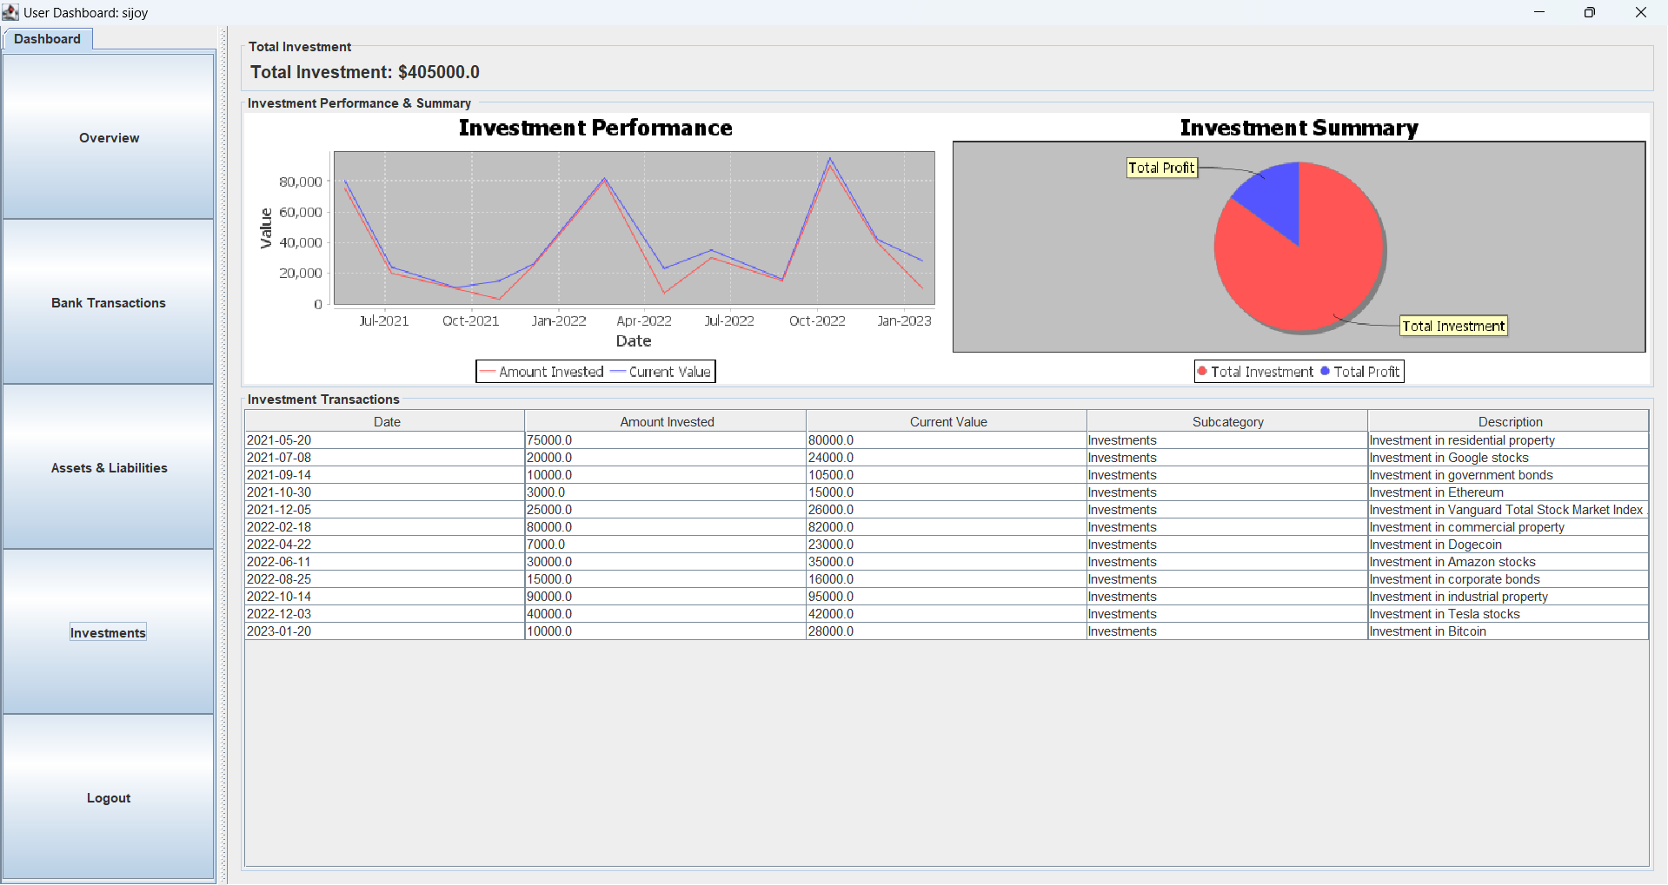
INVESTMENTS PANEL

Slide 7
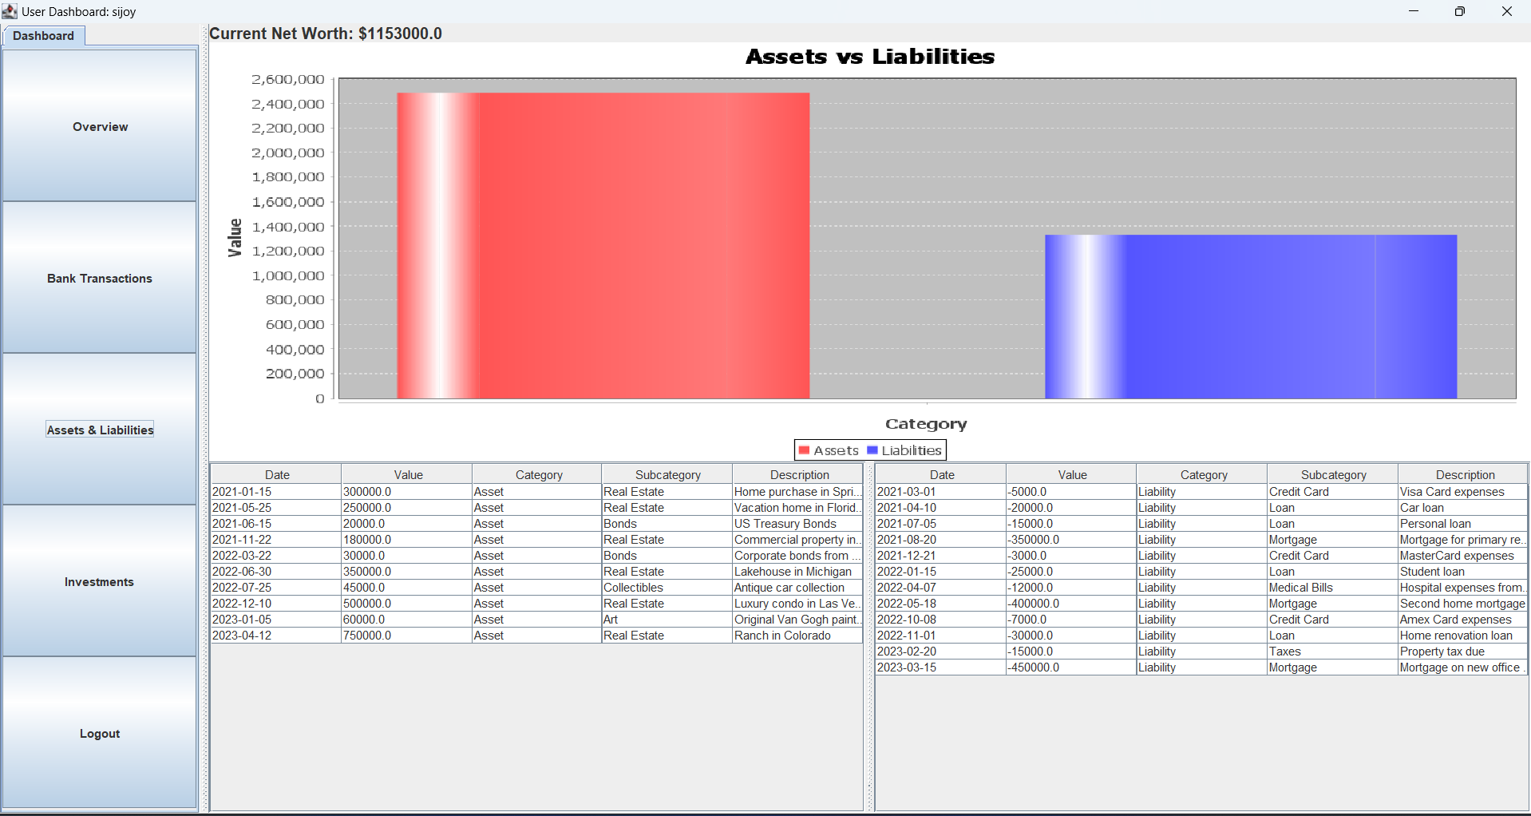
ASSETS & LIABILITIES PANEL

Slide 8
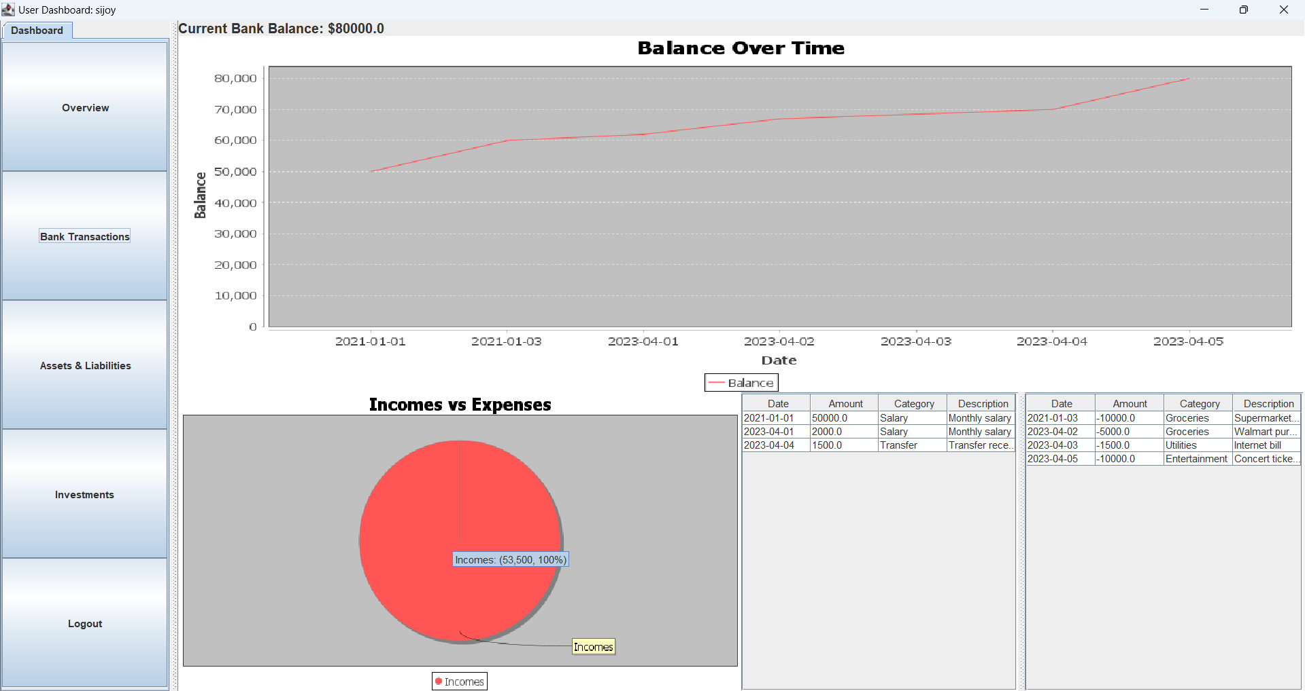
BANK TRANSACTIONS PANEL

Slide 9
FUTURE SCOPE
Predictive Analytics:
Implement predictive analytics algorithms to forecast future financial trends based on historical data.
Provide users with insights into potential investment opportunities and risk assessment.
Mobile App Version:
Develop a mobile application for iOS and Android platforms, offering users convenient access to their financial data on-the-go.
Ensure seamless synchronization with the desktop version for a unified user experience across devices.
Integration with Financial Institutions:
Establish connections with banks and financial institutions via APIs to enable automatic retrieval of transaction data.
Streamline the process of updating user accounts with real-time transaction information, reducing manual data entry efforts

Slide 10
Thank You

